Slide 1
Networking VLAN
400IT – W3-S1

Slide 2
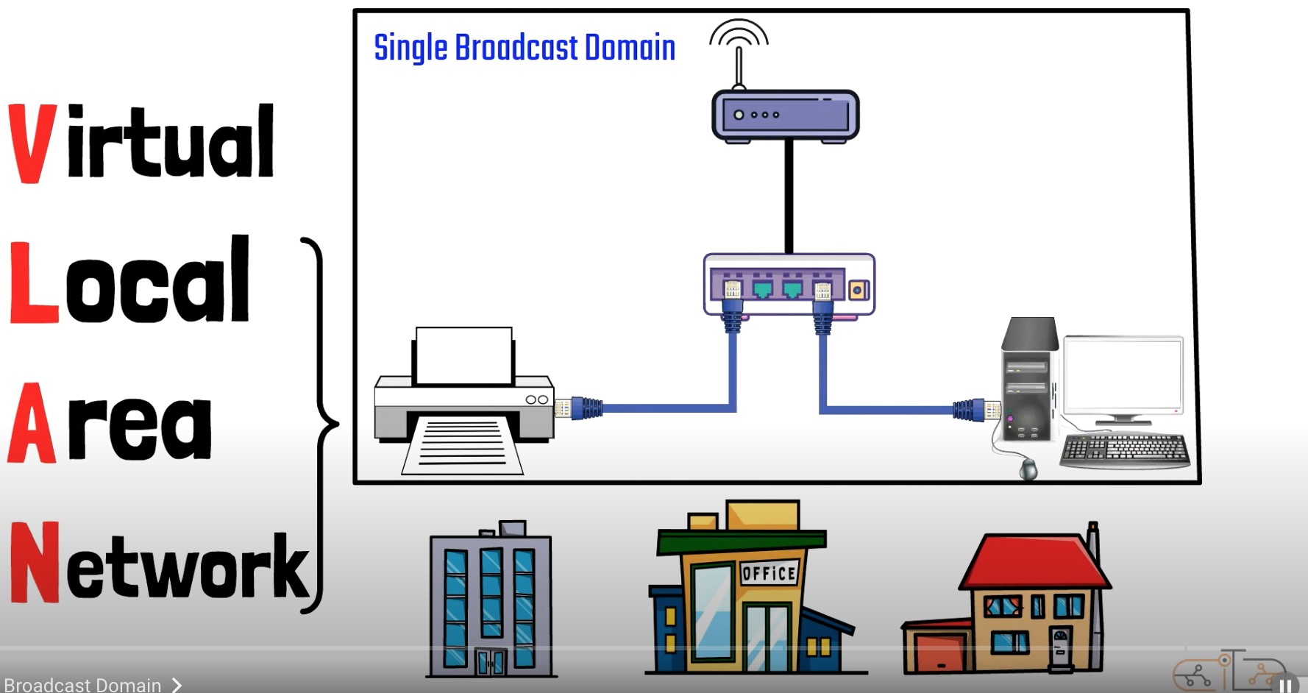
VLAN

Slide 3
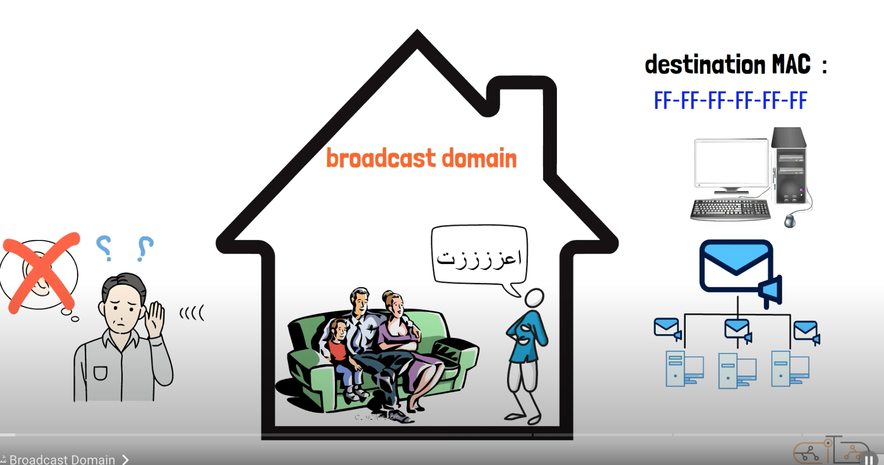
VLAN

Slide 4
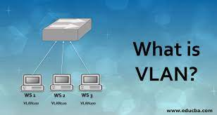
VLAN Definition
VLAN : VLAN stands for Virtual Local Area Network, a technology that enables the segmentation of a physical network into multiple logical networks within the same physical infrastructure.

Slide 5
Purpose of VLAN
Purpose: VLANs allowing organizations to enhance network organization and management. This segmentation is achieved without the need for additional physical hardware.
VLANs reduce broadcast traffic by isolating network segments.

Slide 6
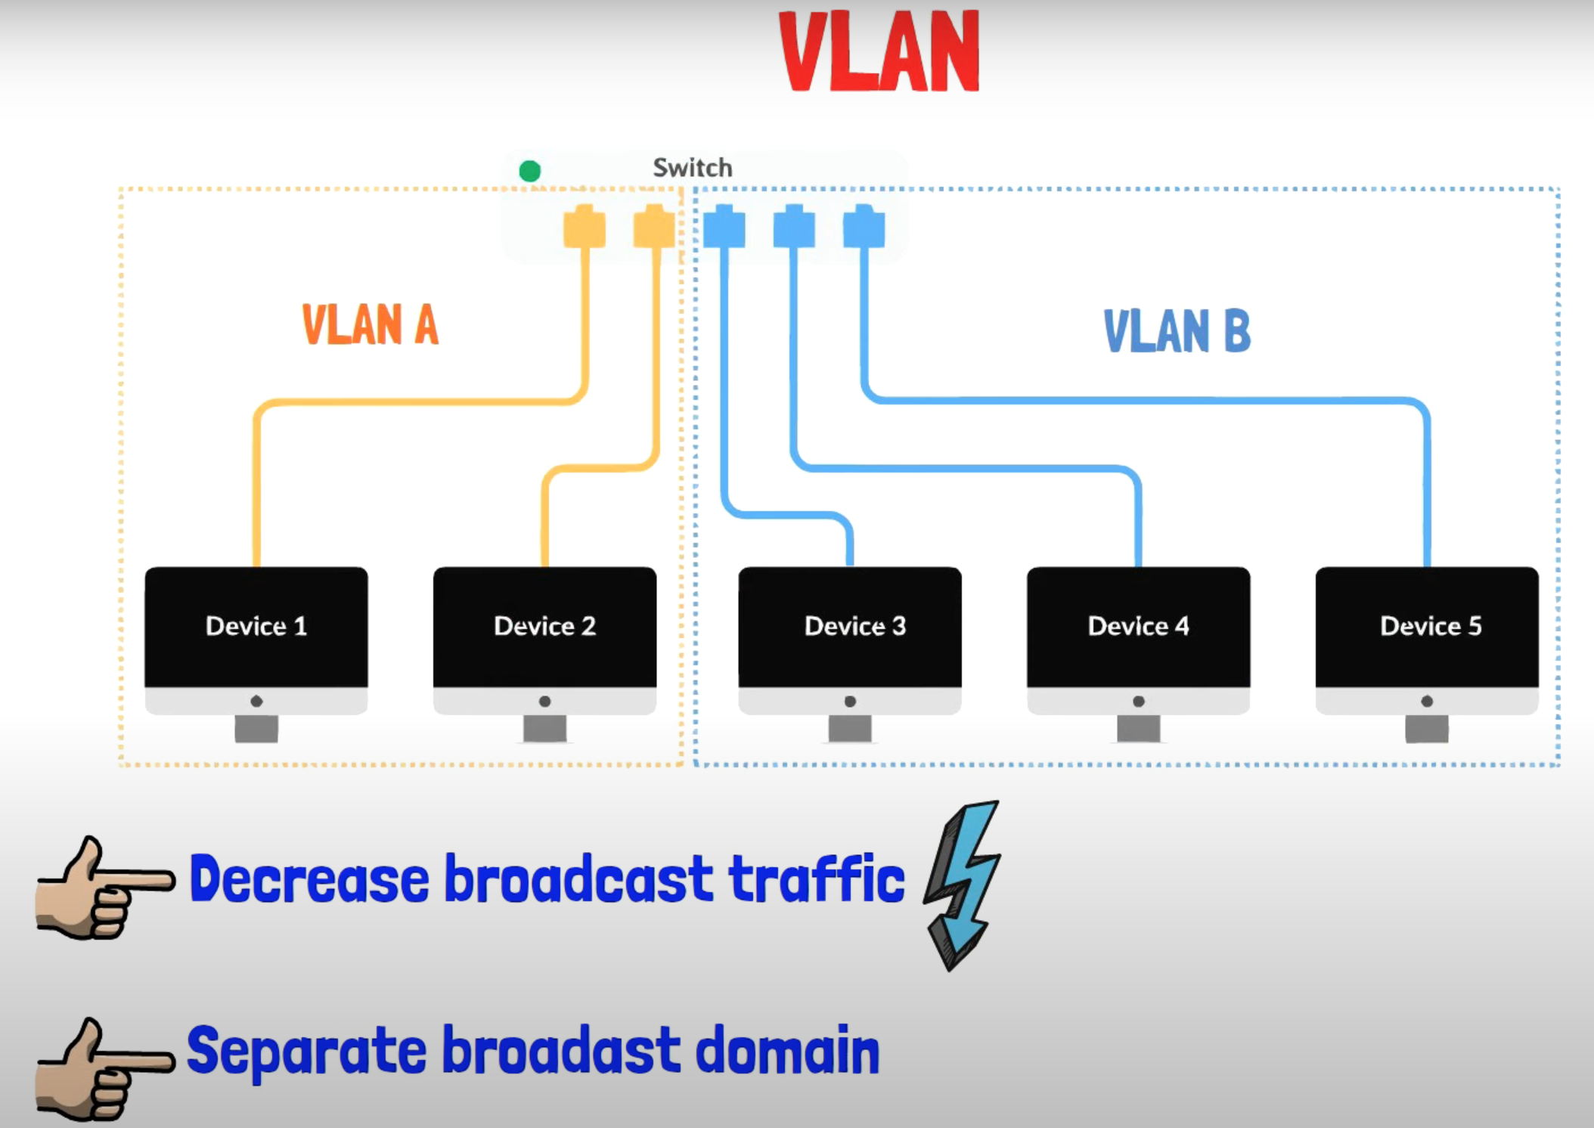
VLAN

Slide 7
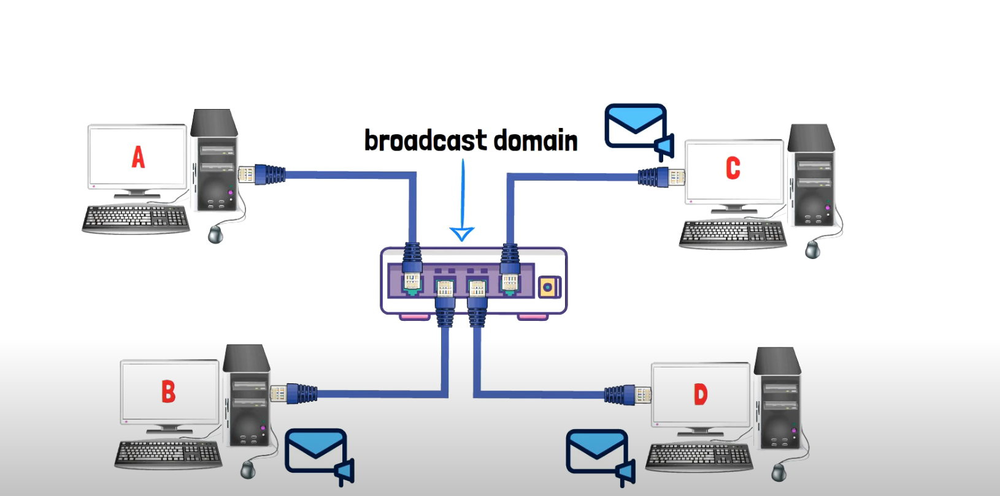
Broadcast domain for small Network

Slide 8
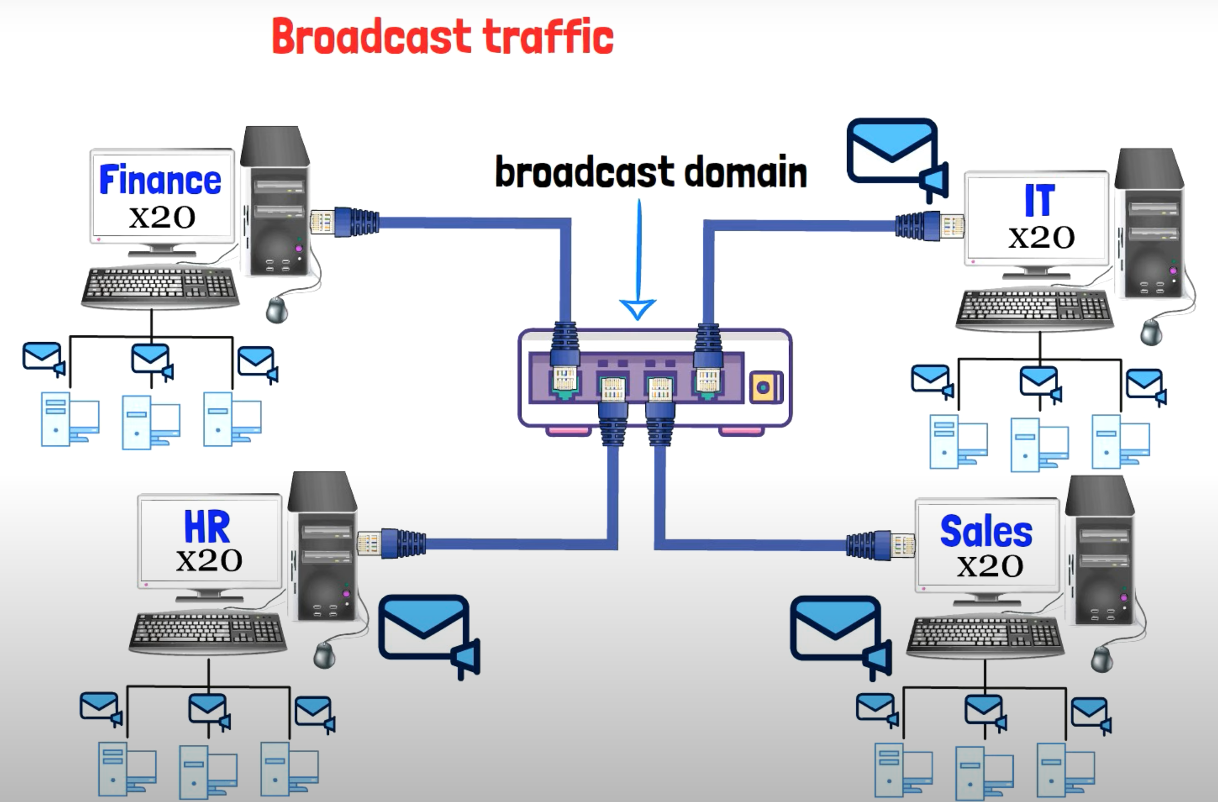
Broadcast domain for Big Network

Slide 9
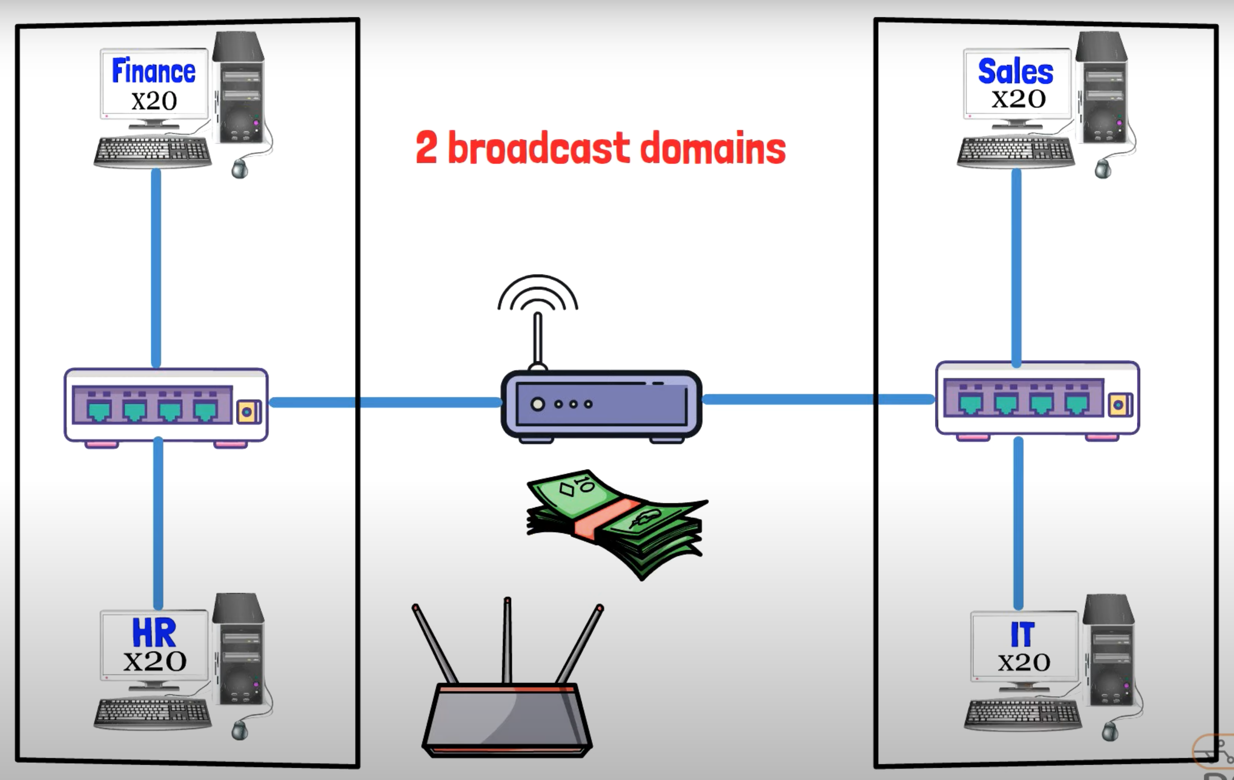
Router

Slide 10
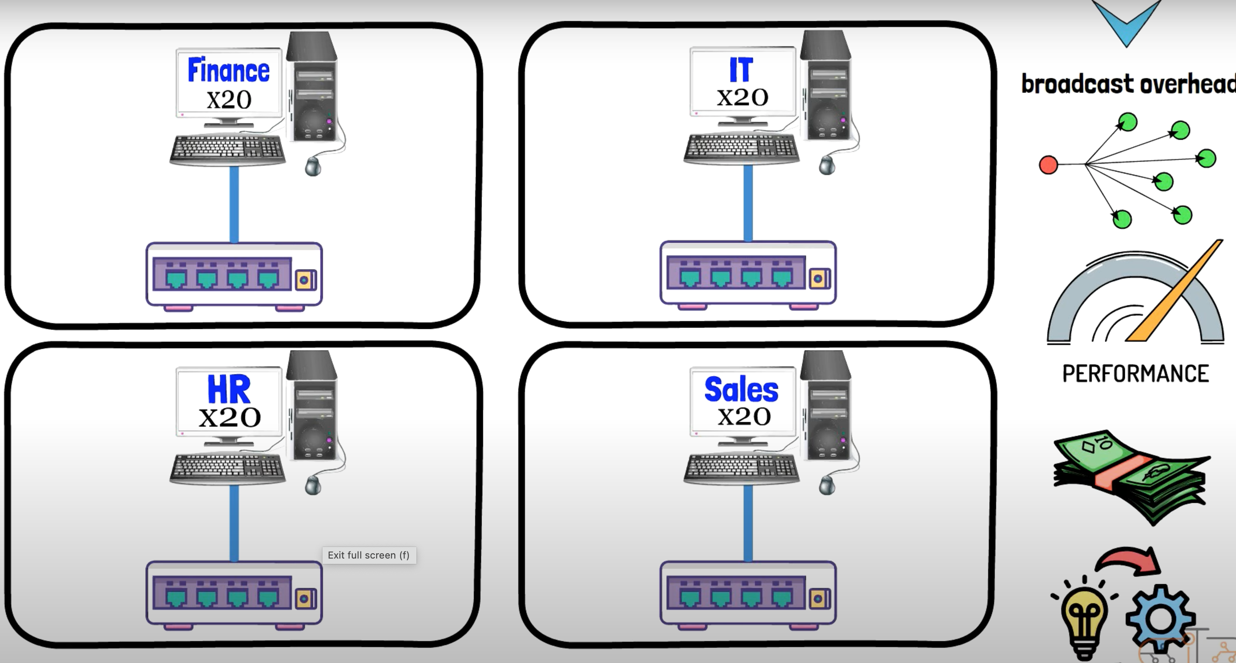
4 Swithes

Slide 11
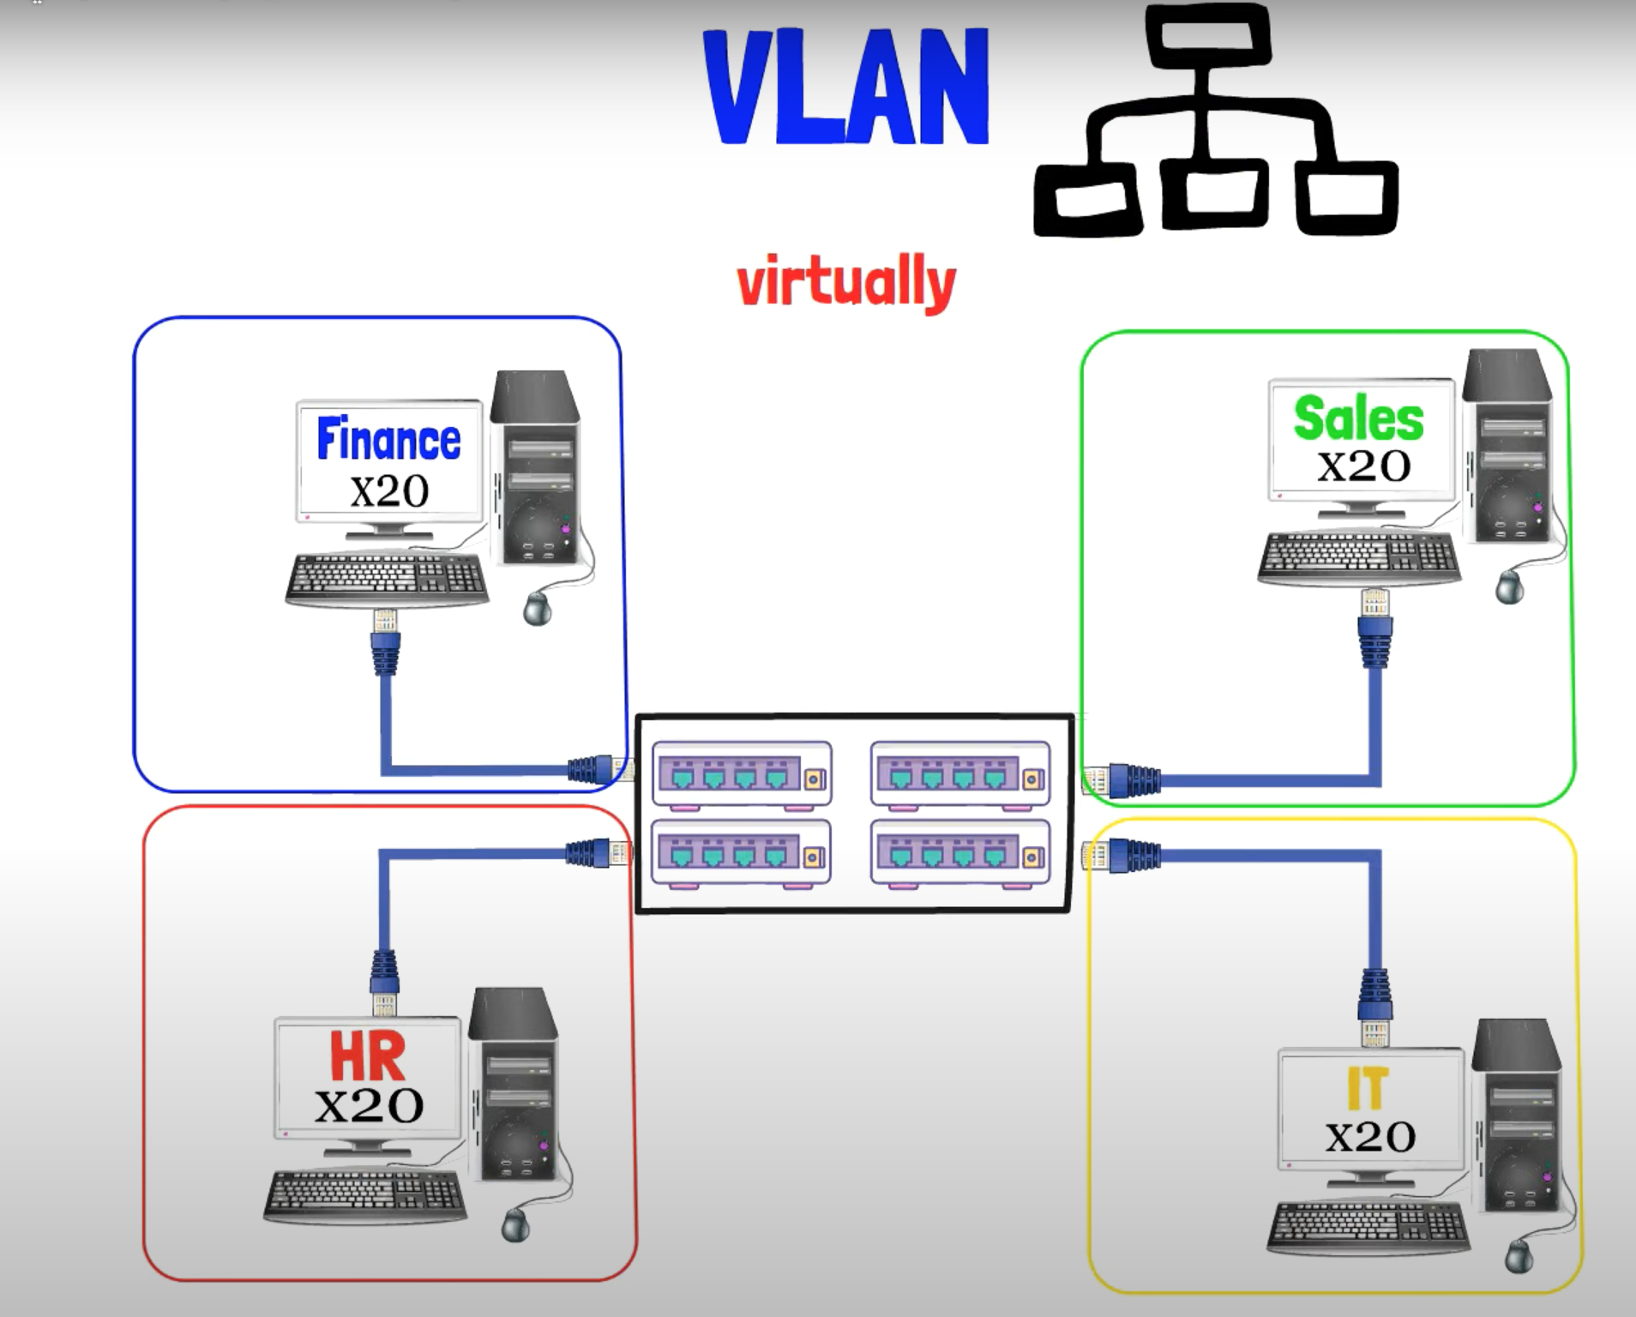
VLAN

Slide 12
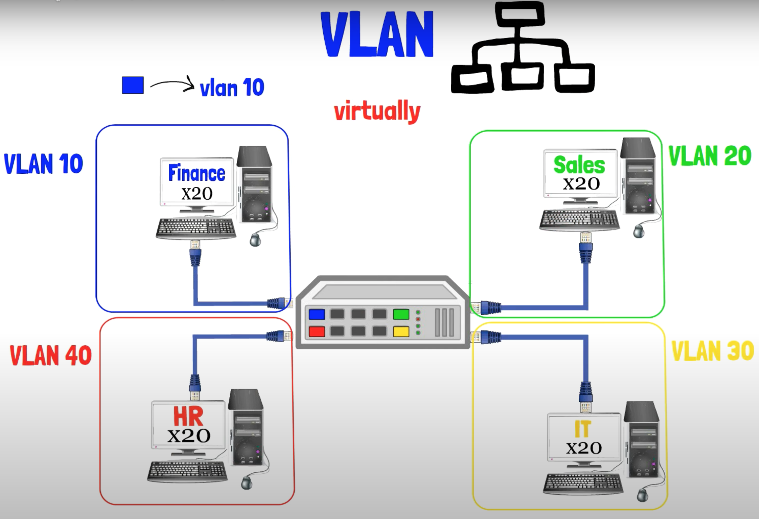
VLAN

Slide 13
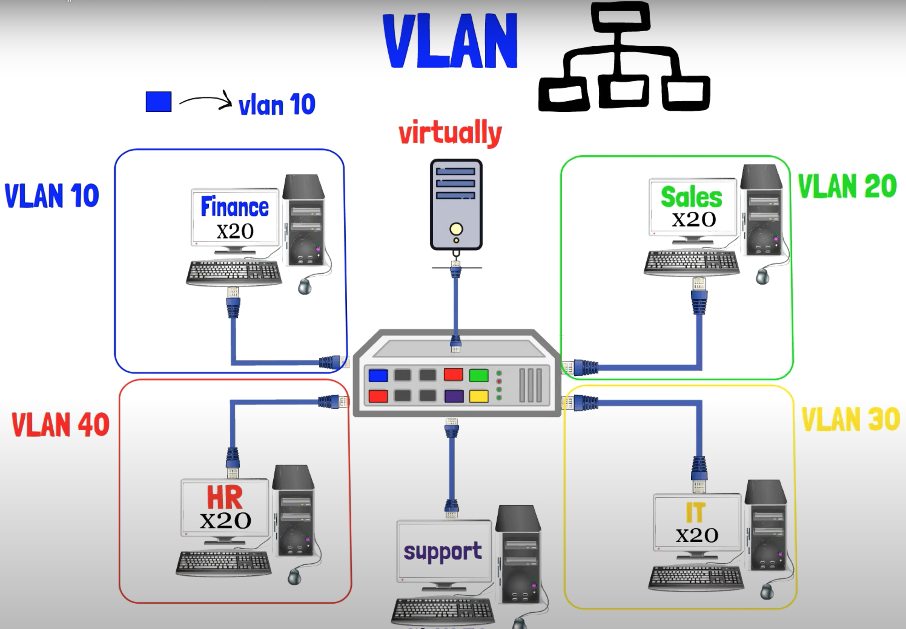
Add Devices

Slide 14
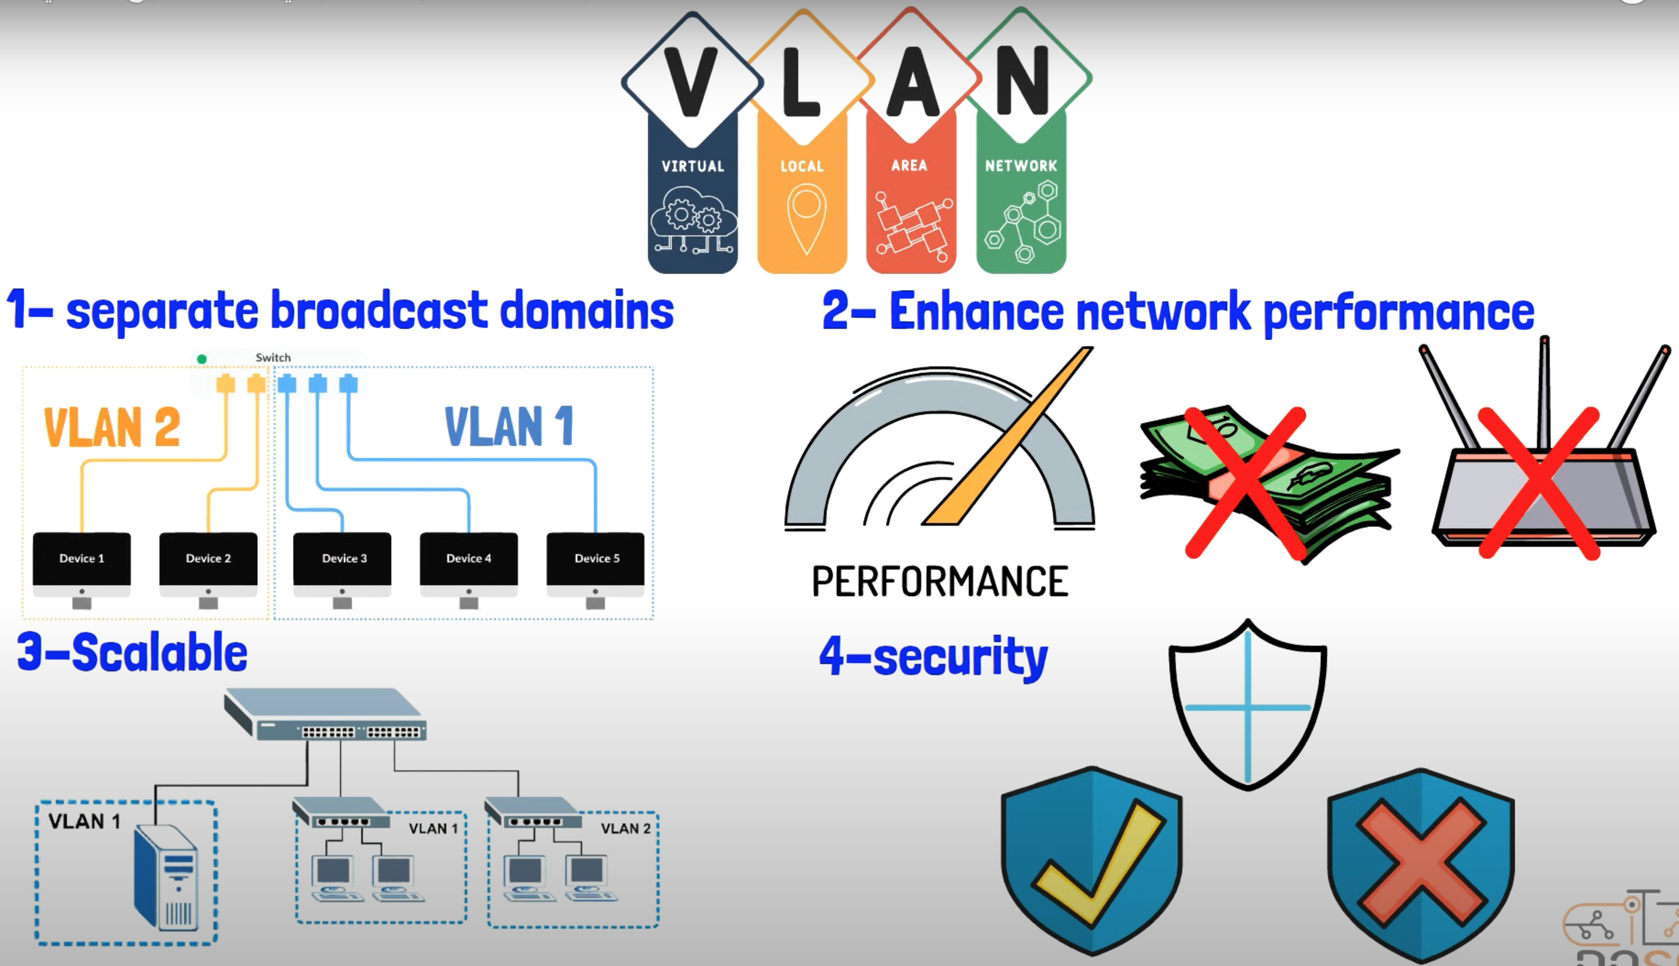
Benefits

Slide 15
Benefits
Improved Network Performance: VLANs reduce broadcast traffic, leading to faster and more efficient data transmission within each VLAN.
Enhanced Network Security: VLANs isolate network segments, preventing unauthorized access and data breaches by containing traffic within designated VLANs.
Efficient Resource Utilization: VLANs allocate resources effectively by tailoring configurations to meet specific application or user needs.
Simplified Network Management: VLANs simplify administration and troubleshooting by grouping devices based on functions or security requirements.
Scalability: VLANs support network growth and adaptation to evolving business needs without major infrastructure changes.

Slide 16
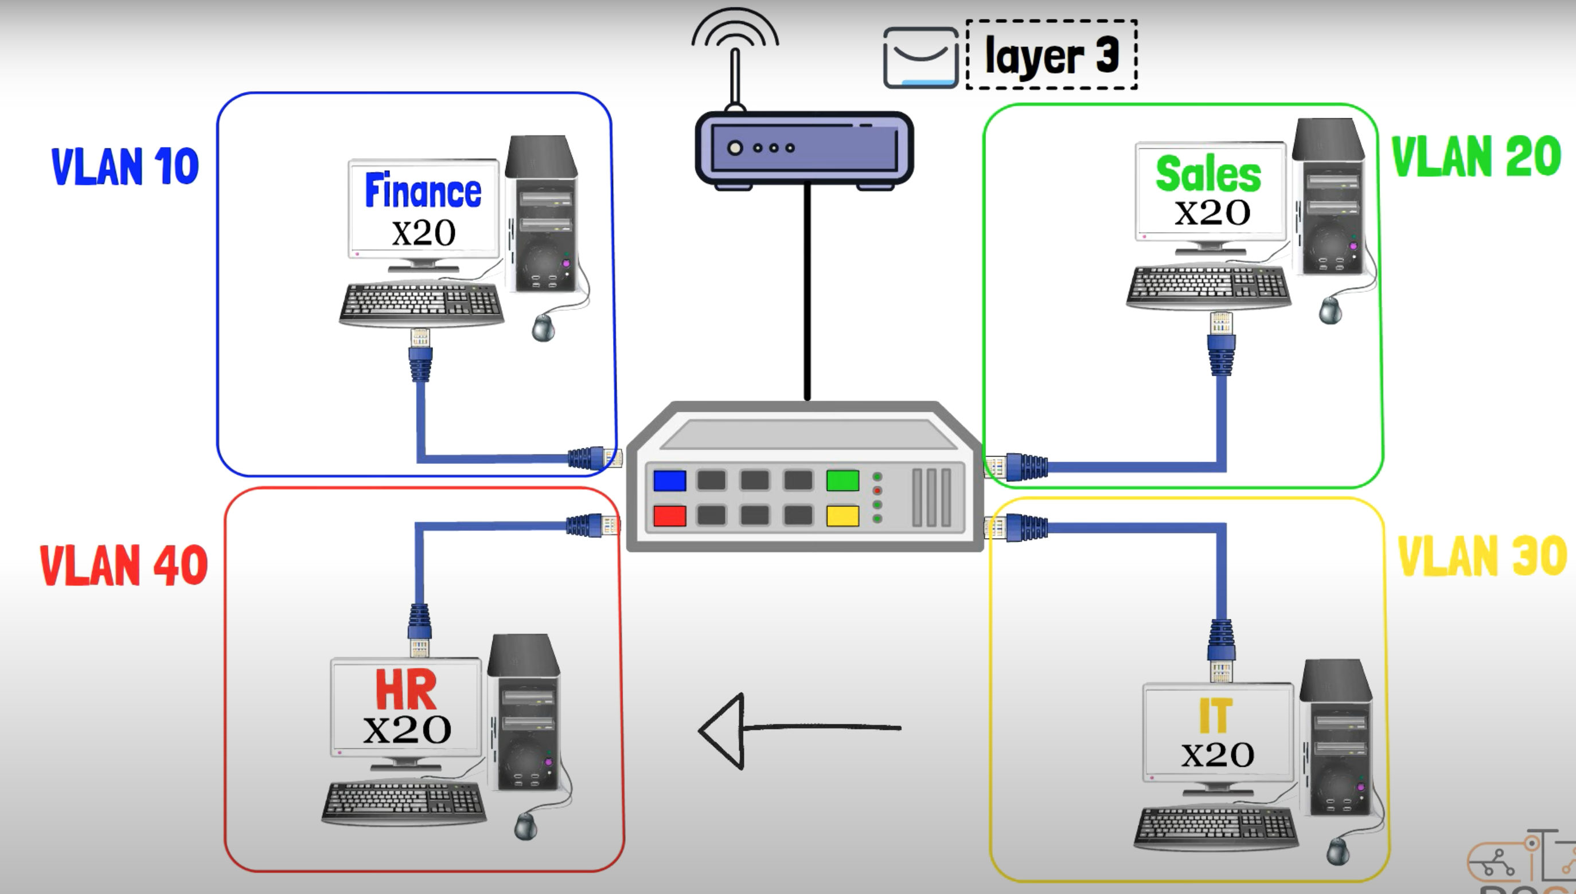
How is it work

Slide 17
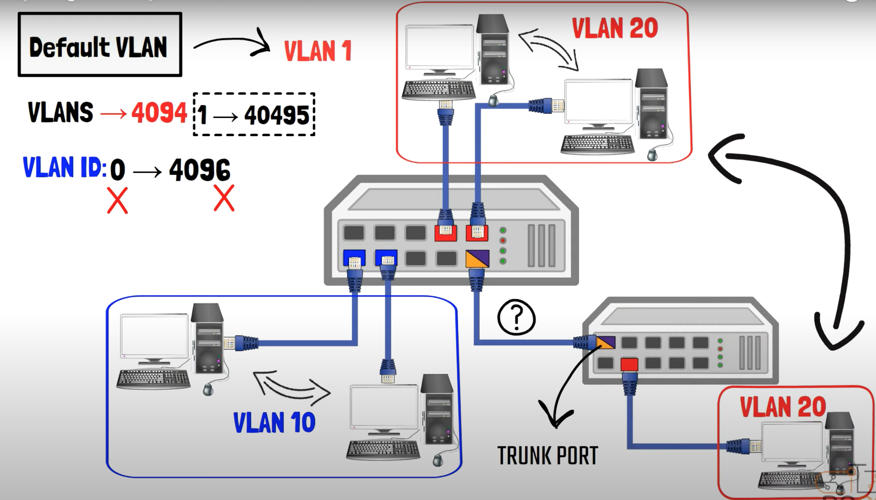
VLAN

Slide 18
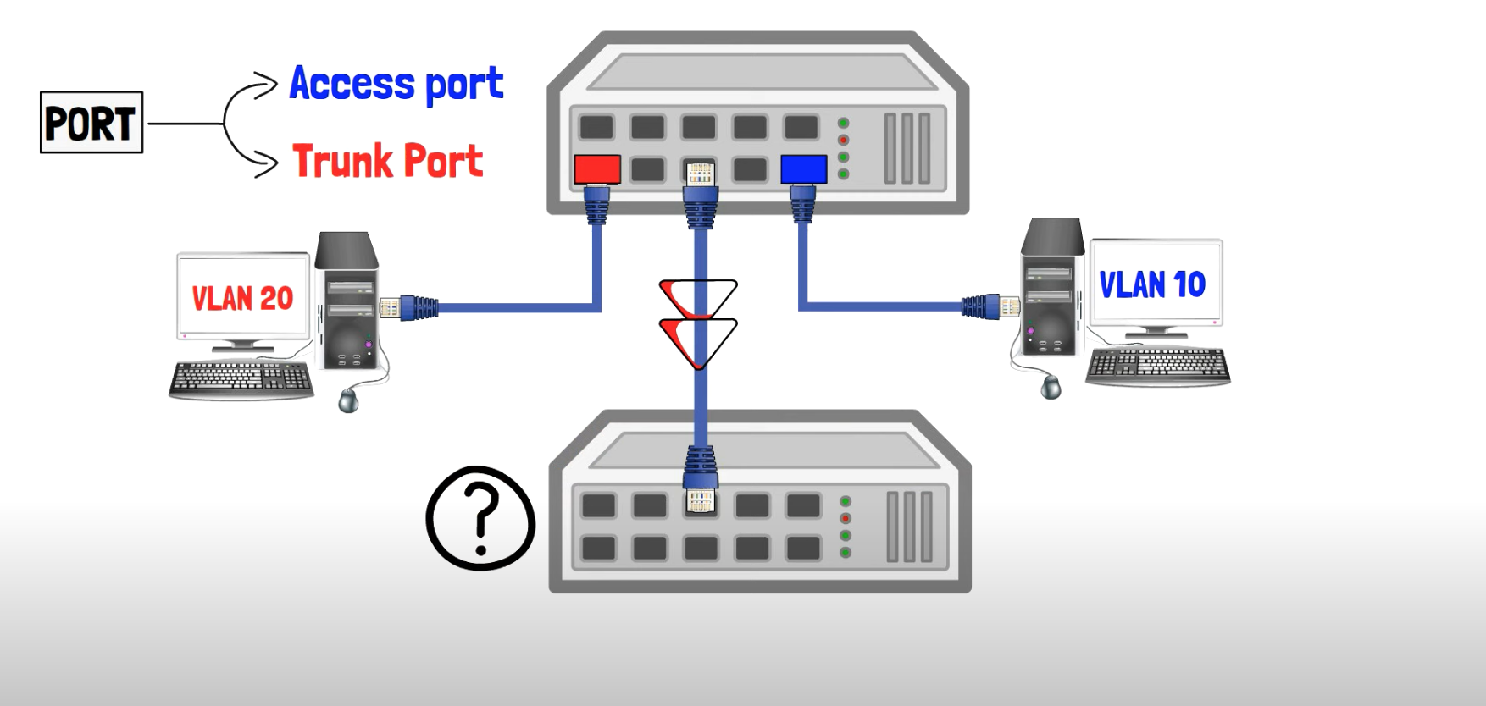
Port Type

Slide 19
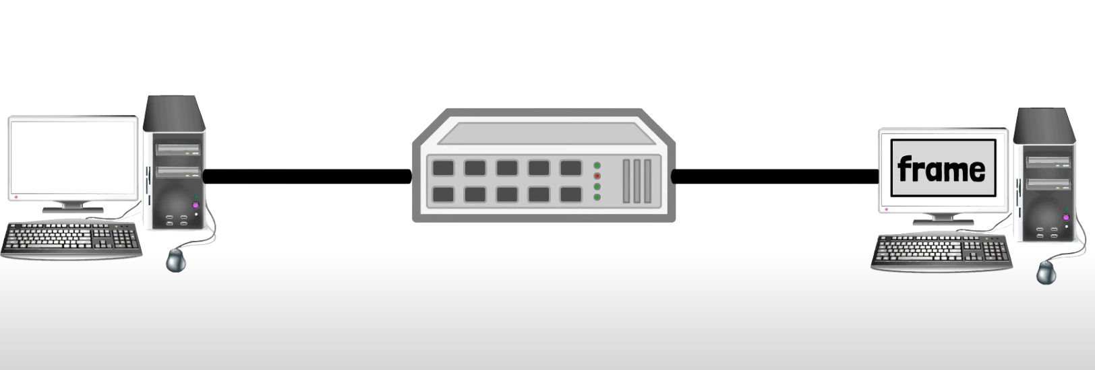
Frame

Slide 20
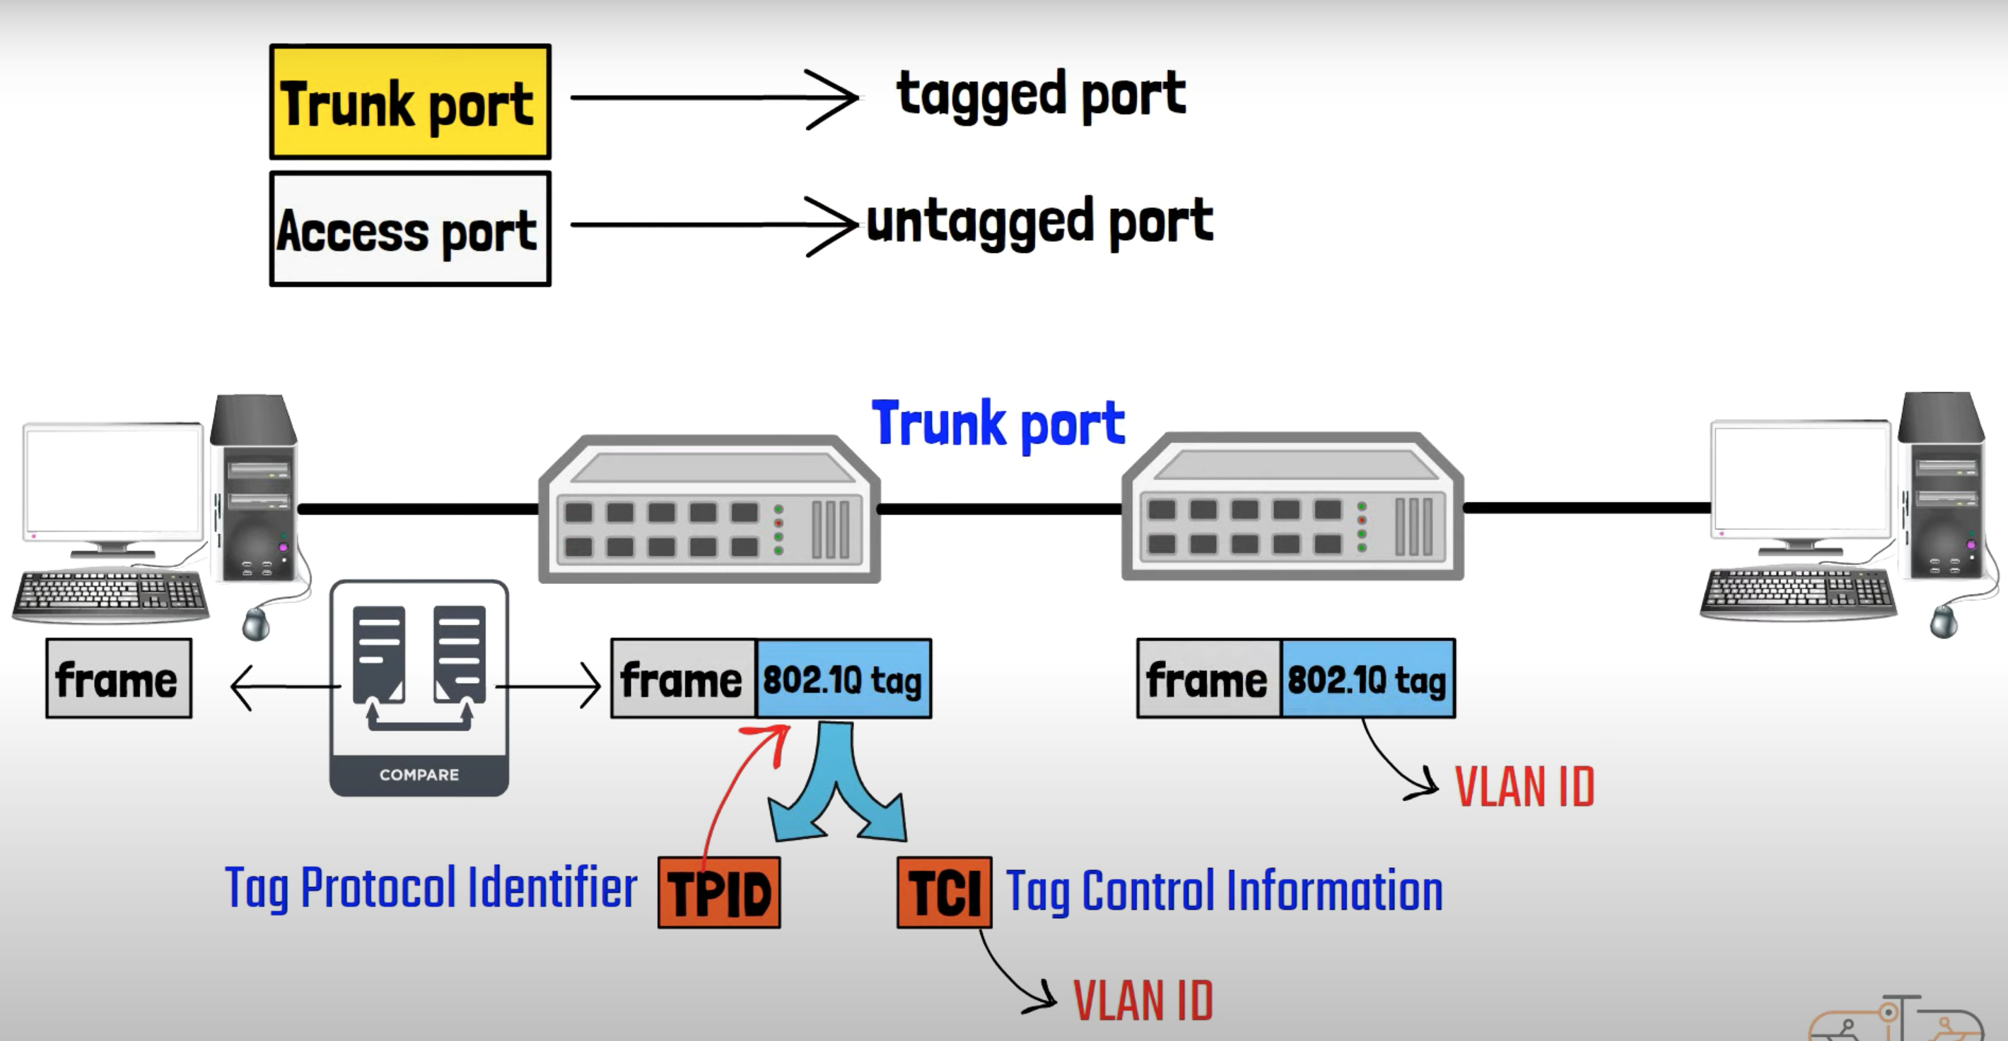
802.1Q Tag

Slide 21
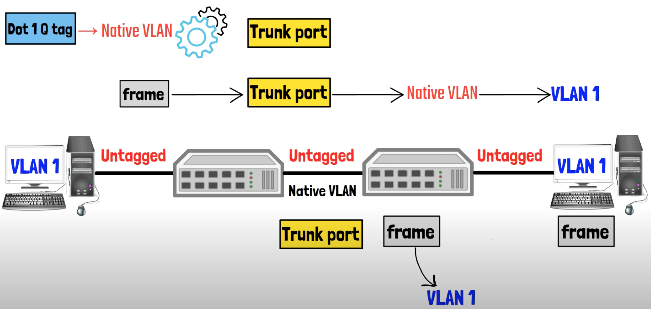
Native VLAN

Slide 22
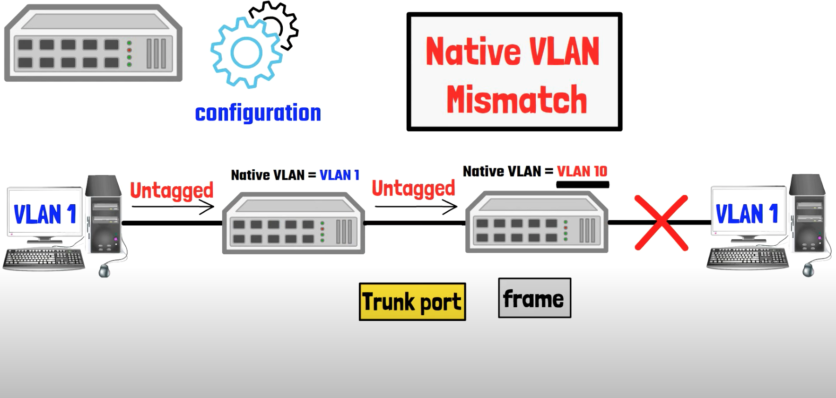
Native VLAN

Slide 23
Native VLAN

